Slide 1
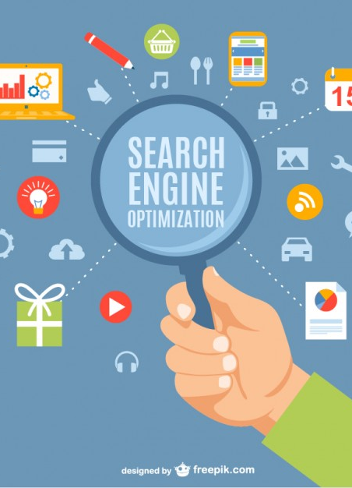
WEB SEARCH ENGINE GROUP 1
GROUP MEMBERS:
ABISHEK RAJGOPAL
DISHANT SHAH
NEEL PATEL
SAYEE SHRUTHI
YouTube Link: https://youtu.be/2pqgJI1Stmg

Slide 2
PLEDGE
As a student of the University of Windsor, I pledge to pursue all endeavours with honour and integrity, and will not tolerate or engage in academic or personal dishonesty. I confirm that I have not received any unauthorized assistance in preparing for or writing this assignment. I acknowledge that a mark of 0 may be assigned for copied work.” - Neel Patel(110035184)

Slide 3
MY ROLE
I developed a ranking mechanism for web search engine that sorts the webpages in decreasing order of frequency of single word present in search query.
I also developed the same mechanism for multiple words in single search query which prioritized output 4 that had maximum occurrences of both word in single file.
I did this with the help of Hash-map & document-term matrix. A document-term matrix is a matrix that describes the frequency of terms that occur in a collection of documents.

Slide 4
What is WEB SEARCH ENGINE?
The most productive way to conduct a search on the internet is through a search engine.
A web search engine is a software system designed to search for information on the World Wide Web. The search results are generally presented in a line of results often referred to as search engine results pages (SEROs).
The information may be a mix of web pages, images, and other types of files. Some search engines also mine data available in databases or open directories.

Slide 5

BACKGROUND STUDY
SEarch engine types
Search intents
Crawler based search engine - All crawler based search engines use a crawler or bot or spider for crawling and indexing the new content to the search database
Human powered directories – Depends on human based activities for listings.
Hybrid search engine– Using both crawler based and manual indexing for listings the sites in search results.
Informational
Navigational
Transactional

Slide 6
Difficulties of building a search engine
Build by Companies and hide the technical detail
Distributed data
High percentage of volatile data
Large volume
Unstructured and redundant data
Quality of data
Heterogeneous data
Dynamic data
How to specify a query from the user
How to interpret the answer provided by the system

Slide 7
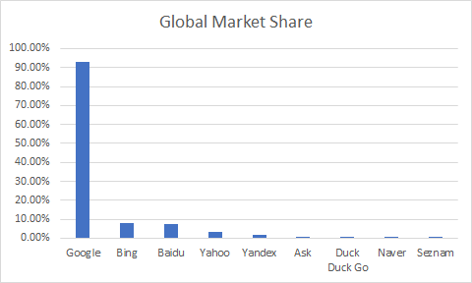
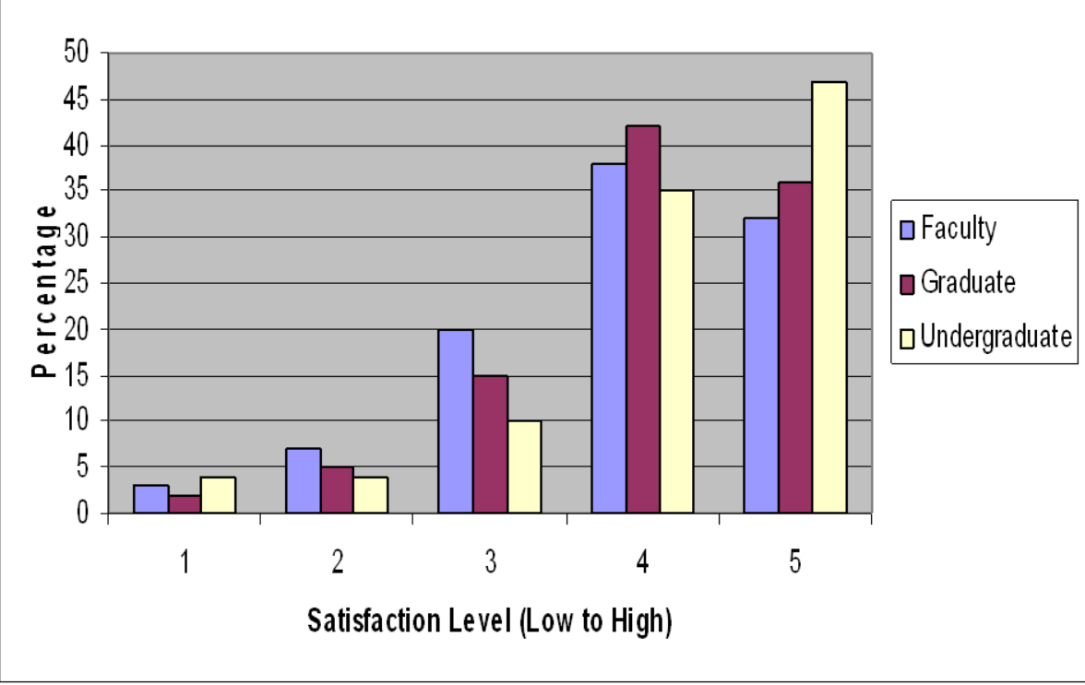
Search Engine | Global Market Share | Key Points
Google | 92.80% | THE BIG BULL
Bing | 8.04% | Owned By Microsoft
Baidu | 7.34% | Used in China
Yahoo | 3.34% | Powered by Microsoft, get similar results to Bing
Yandex | 1.53% | Used in Russia
Ask | 0.72% | Child of Google
Duck Duck Go | 0.39% | Privacy simplied
Naver | 0.13% | South Korea
Seznam | 0.03% | Czech Republic

Slide 8
PROBLEM STATEMENT
Our main objective is to obtain relevant web page URLS for every user search.
We have taken >1000 URL's from websites like GeeksforGeeks and Tutorialspoint as specifics for the built search engine.

Slide 9









CONCEPTS USED
Edit Distance – Dynamic Programming
Jsoup
Splay Trees
Document-term
Hash Map
Merge Sort
AWT
Regular expression
Inverted index

Slide 10
Tools Used
IDE: Eclipse
Reference Libraries: JSoup, Lucene
Packages : java.util.*, java.io.*

Slide 11
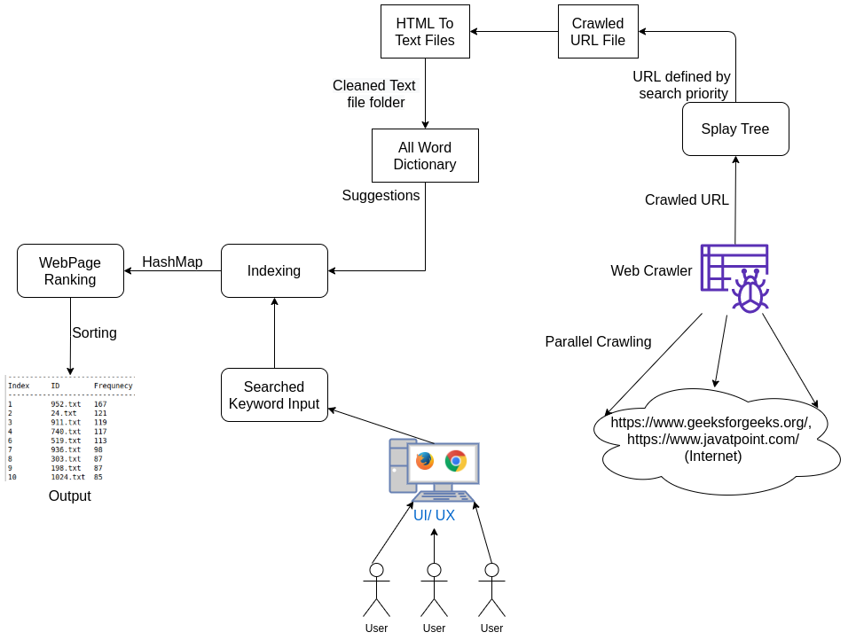
BLOCK DIAGRAM

Slide 12
FEATURES:
Crawling
Parallel Web Crawling
Splay Trees Insertion with distinct links
Text Processing
HTMLtoText Conversion
Text Preprocessing (Removing stop words)
Make dictionary
Suggestions
Inverted Index
Initializing Index using HashMap for words and files
Linear search on user search term
Ranking
Term document creation with word frequency
Sorting results in descending order
UI
Render Search Results

Slide 13
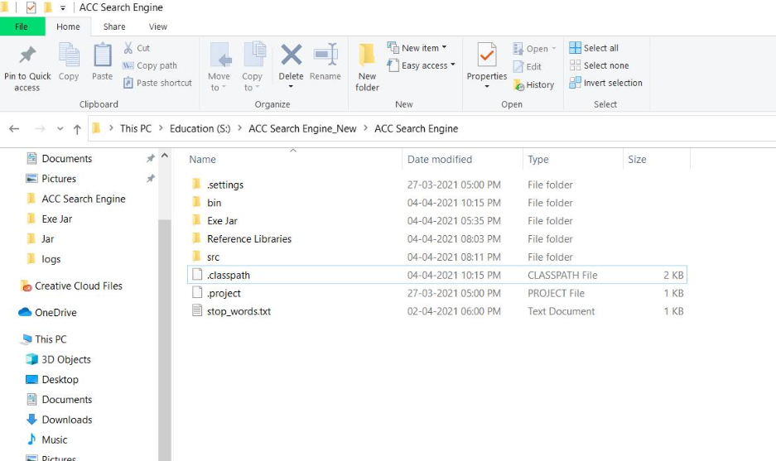
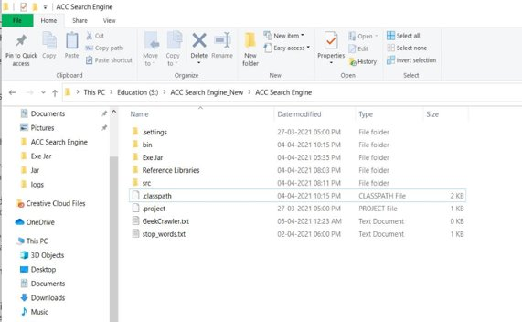
IMPLEMENTATION - Crawling

Slide 14
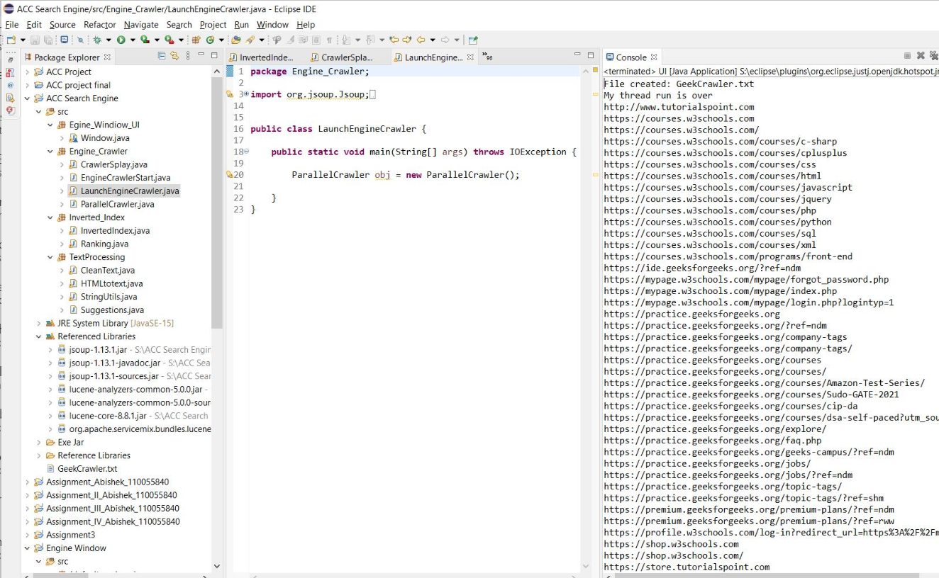
CRAWLING OUTPUT :

Slide 15
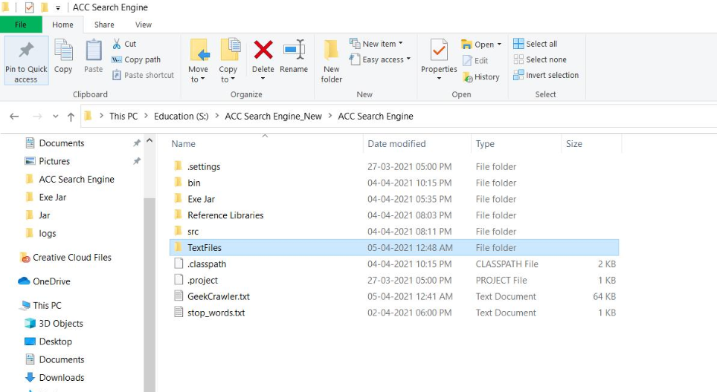
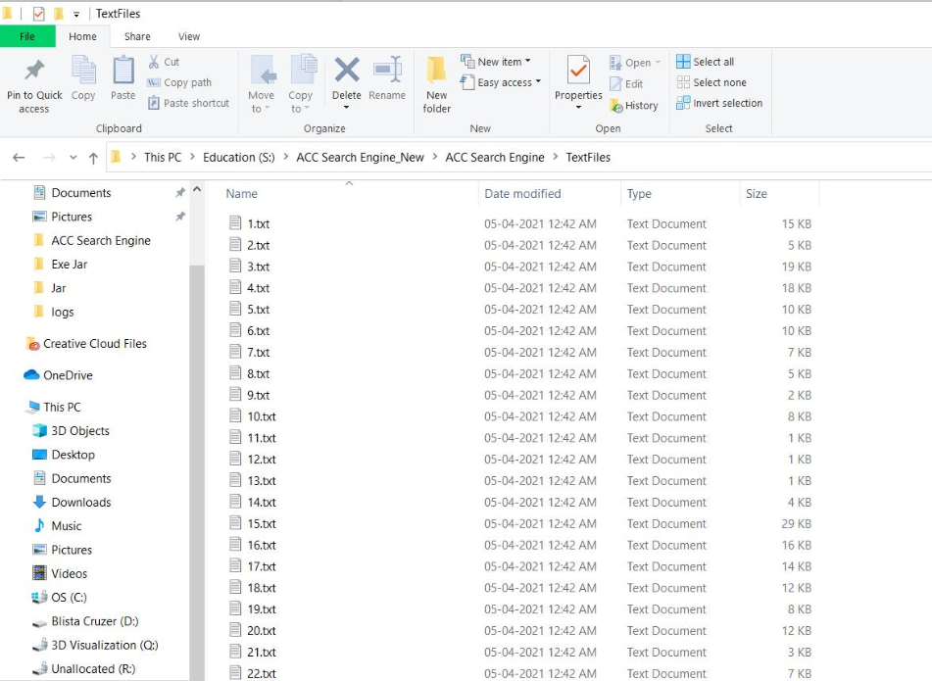
Html TO tEXT CONVERSION
HTML Files are converted to text files using Jsoup.
Folder Text file is created which consist of all converted text files.

Slide 16
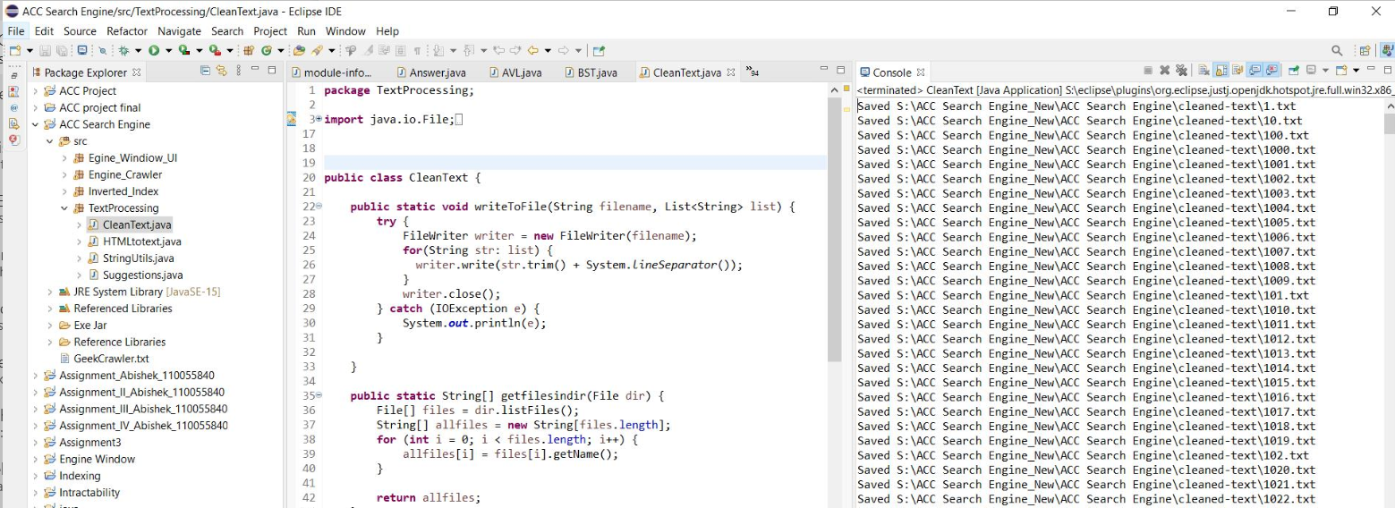
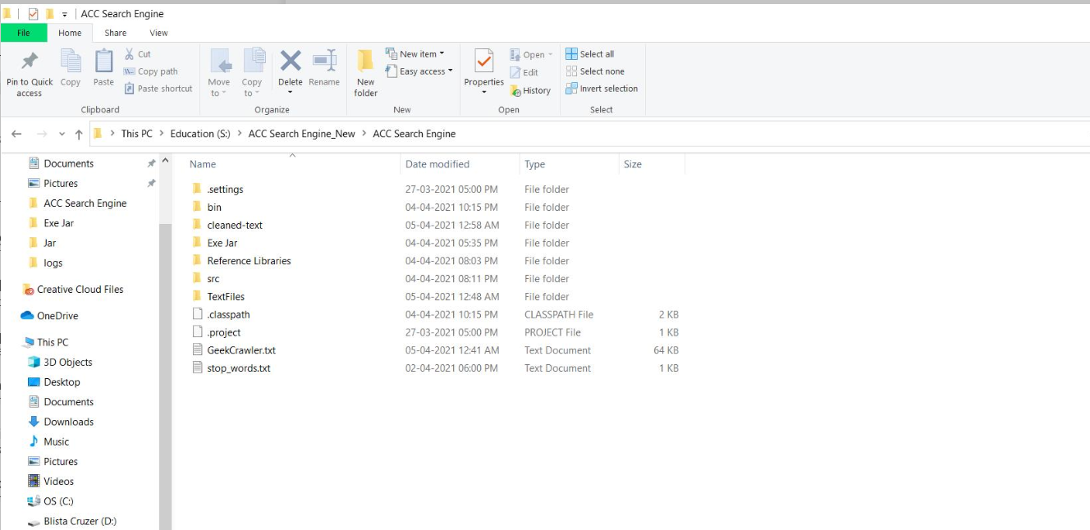
TEXT PROCESSING
Converted text files are preprocessed by removing stop words like "a, the"
We loop through TextFiles folder, find the literal tokens using lucene library. We clean the text with regular expression and write into separate folder cleaned-text.

Slide 17
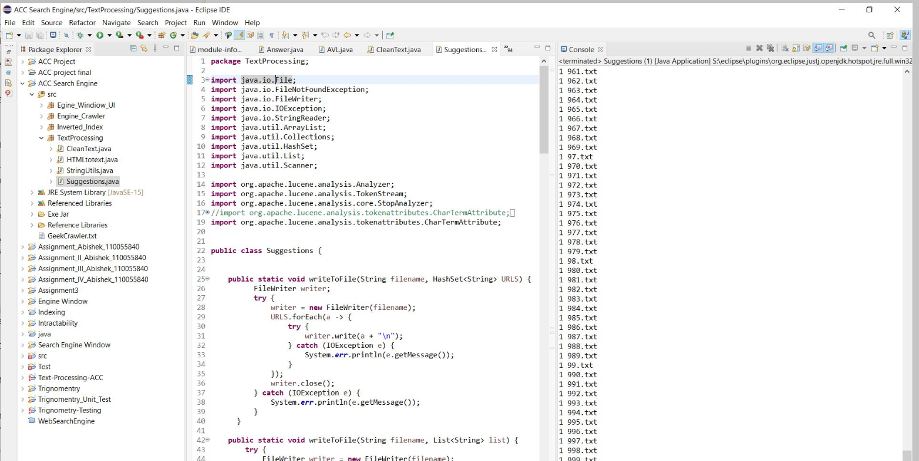
SUGGESTIONS
A Dictionary is made with Token Analyzer which collects all root words from clean text.
Suggestions are given for the user input based on minimum edit distance.
Spell checks are handled using edit distance.

Slide 18
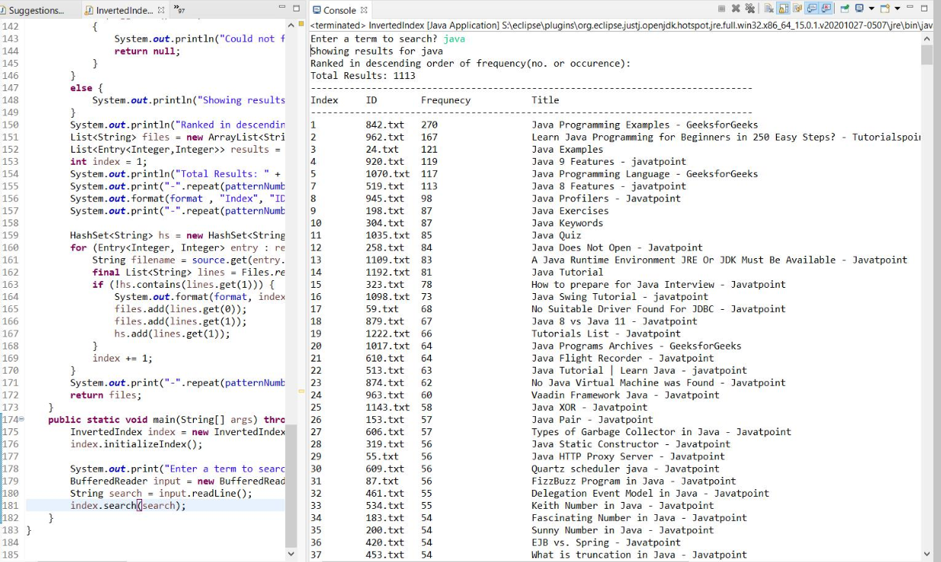
INVERTED INDEX
Two HashMaps are created Initially – a) Index with File name and b) Words and Filename they exist in
Searching, will check for the word in the dictionary, if spelling is wrong will check for suggestions and later search takes place using the HashMap to find all the files with a given word
The Output files are given to the webpage ranking algorithm for sorting based on frequency.

Slide 19
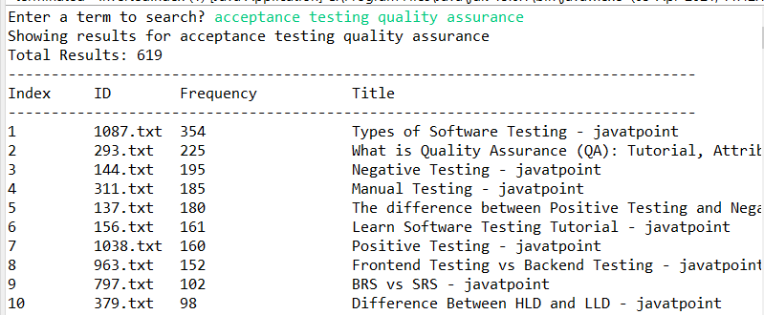
RANKING
Search results are displayed in the decreasing order of frequency of the word present in the file.
In case of searching multiple words, files having highest occurences of those multiple words is displayed in the top(as shown in screenshot).
Sorting is done using Collections.sort function which sorts using Mergesort in Java.

Slide 20
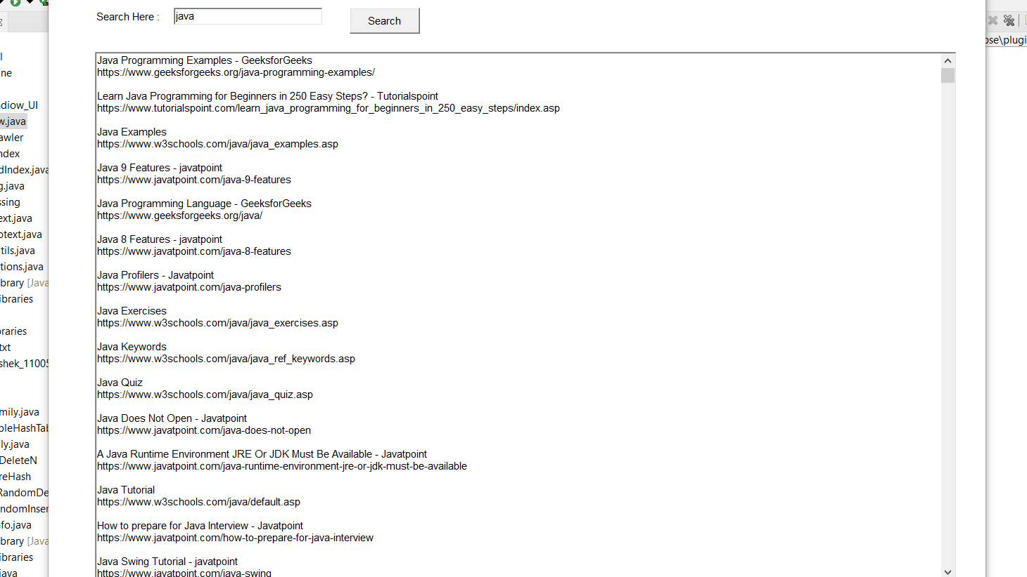
FINAL OUTPUT

Slide 21
FUTURE SCOPE:
Improved results using Pagerank Algorithm
Web Based UI/UX
Web search query for more detailed results
Images, News, Videos Classified Search Results

Slide 22
REFERENCES:
https://jsoup.org/apidocs/overview-summary.html
Referred codes from Advanced Computing LAB session.
https://livebook.manning.com/book/lucene-in-action-second-edition/chapter-4/38
GeeksforGeeks | A computer science portal for geeks
https://www.geeksforgeeks.org
https://www.geeksforgeeks.org/inverted-index/

Slide 23


CONTRIBUTION
Abishek : Developed Web Crawling function & AWT UI
Dishant : Developed Inverted Index and search using Hash Maps
Neel: Developed Ranking mechanism and Document-term matrix
Sayee Shruthi: Wrote a function for HTML to text conversion, cleaning text and word suggestions

Slide 24
CONCLUSION
Web search engine was developed using concepts discussed in class. The concepts include Regular expressions, Hash tables, Edit distance and Merge Sort, Inverted Index algorithms.
Search engine can crawl the webpages and retrieve them. As a next step it converts html files to text files and scans the word.
During scanning, If the word is not found, the web search engine suggest words related to the searched string using edit distance.
Search results are sorted and displayed in an Applet Window to the user.

